Slide 1
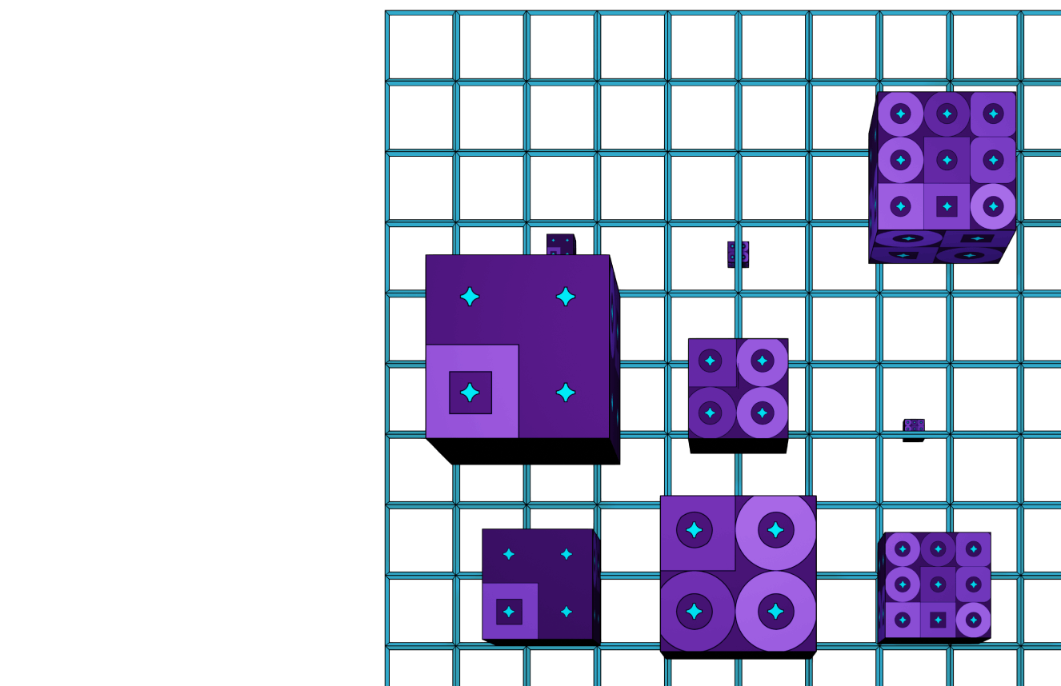
What is
Shared Security?
by Shawn Tabrizi | @shawntabrizi

Slide 2
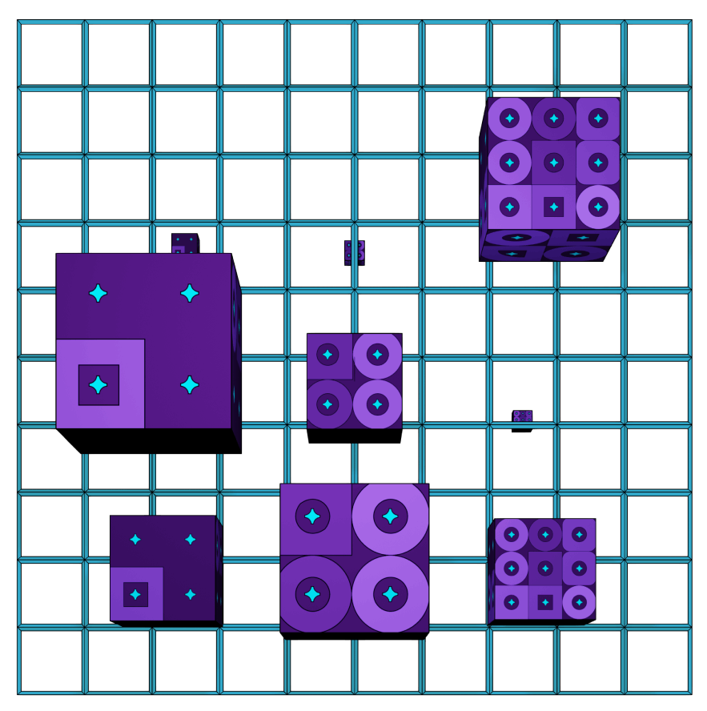
On the surface…
Shared Security is an Economic Scaling Solution for Blockchains.

Slide 3

But that is just an answer that sits at the surface. The topic goes much deeper than that.
Let’s explore…

Slide 4

What is Security?

Slide 5
Security is represented by the economic cost to change the canonical history of a blockchain.
Chains with higher security are more resilient to malicious activity, like a double spend attack.

Slide 6




Note that a double spend is not inherently an attack!
It is perfectly allowed in all blockchain protocols to sign and submit two messages which conflict with one another.
It is up to the blockchain to come to consensus as to which of these two transactions are canonical.

Slide 7
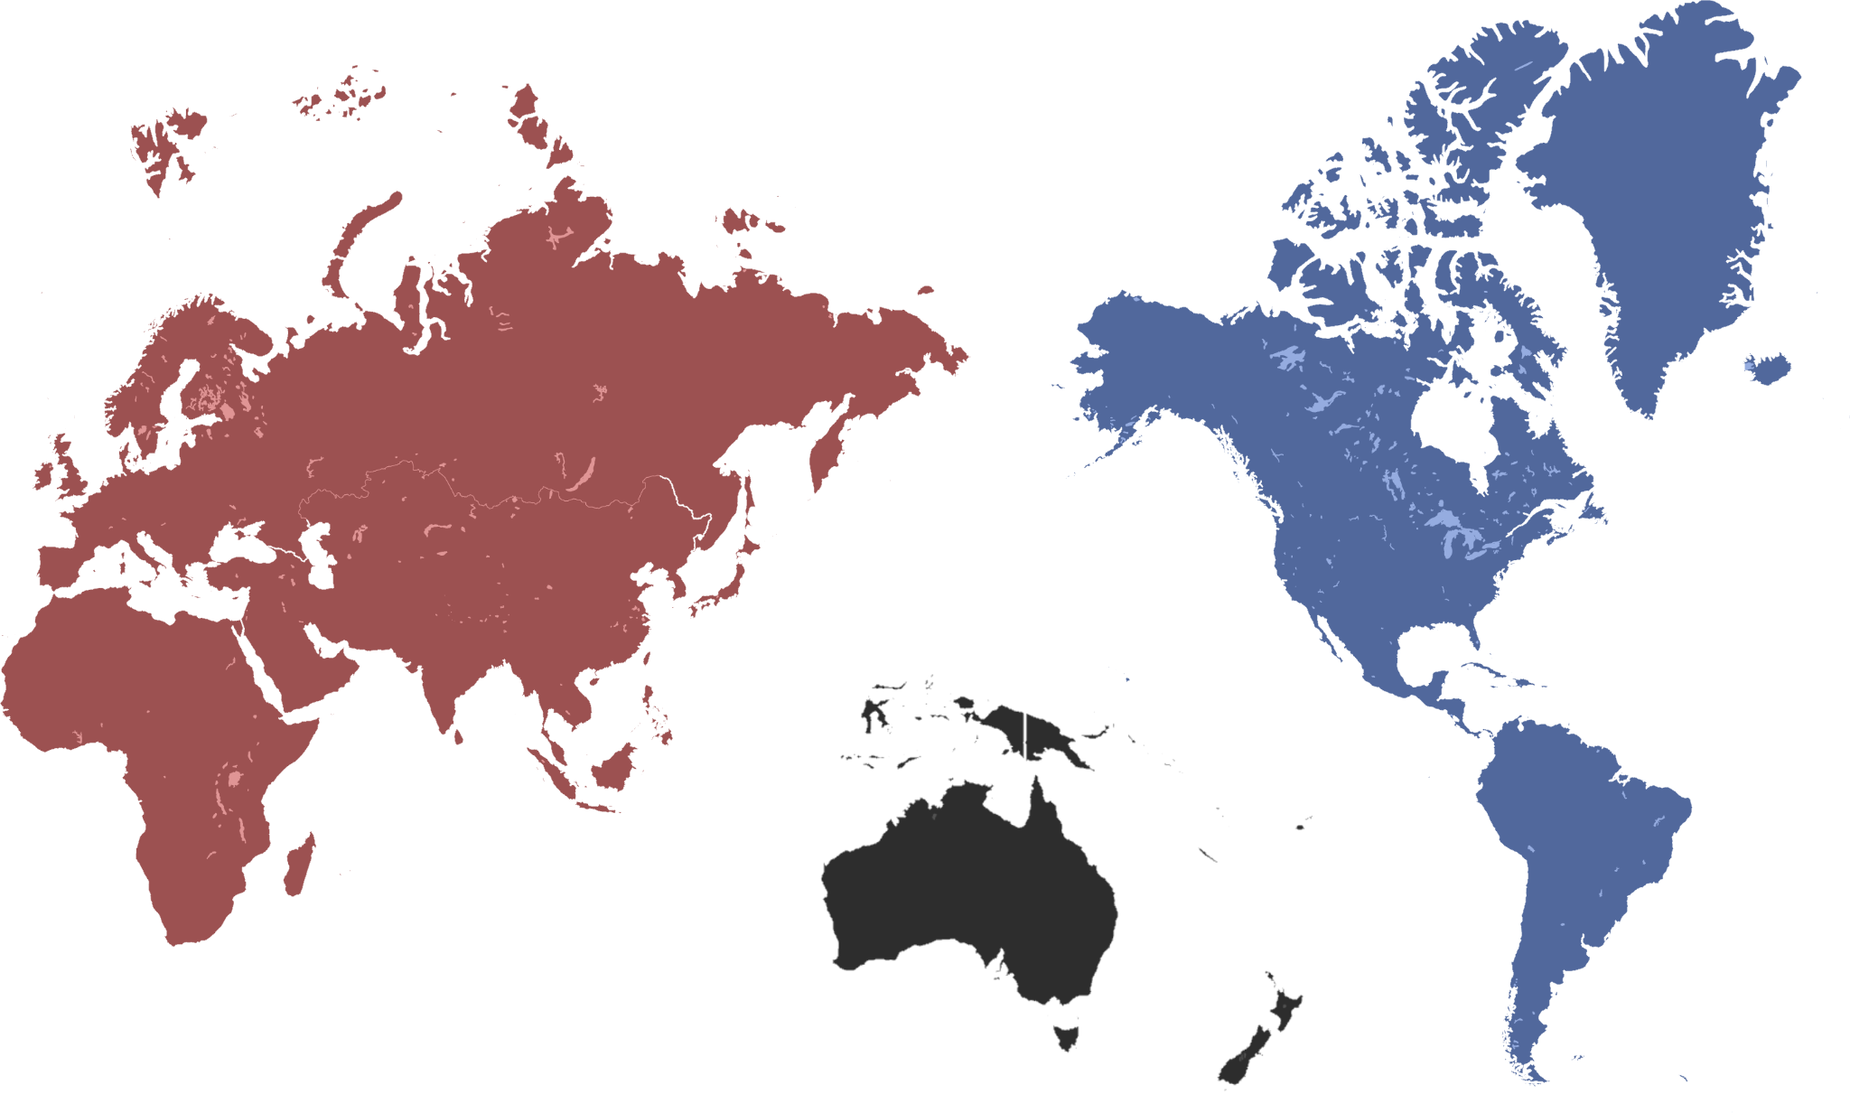
What does an attack look like?
In this example, someone is explicitly taking advantage of fragmentation in the network to try and create two different canonical chains.
33
Honest Nodes
33
Honest Nodes
33
Malicious Nodes

Slide 8
What is the economic cost?
Eventually, the network fragmentation will resolve, and consensus messages will allow us to prove that the malicious nodes equivocated.
That is, they signed messages that validated two conflicting chains.
33
Honest Nodes
33
Honest Nodes
!
!
33
Malicious Nodes
This will result in slashing the malicious nodes, which should be economically large enough to deter these kinds of malicious activities from occurring.

Slide 9
Economics
Security

Slide 10

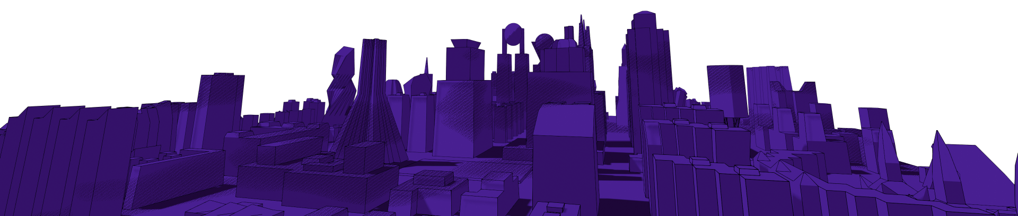
What is the
Bootstrapping
Problem?

Slide 11
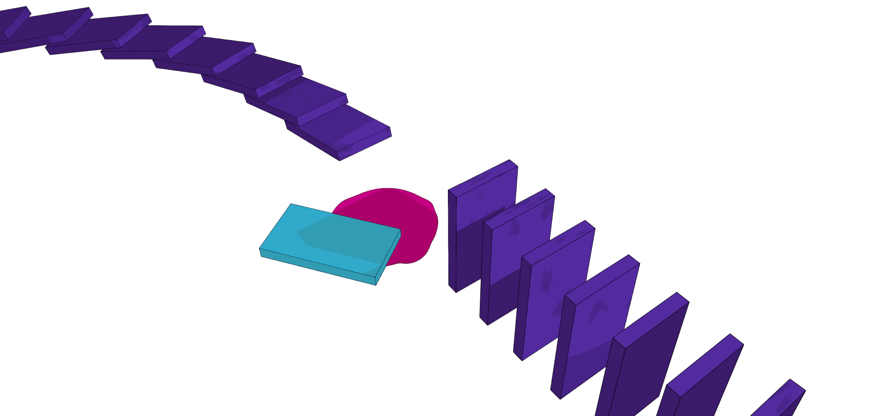
The Bootstrapping Problem
Describes the struggle that new chains face to keep their chain secure, when their token economics are not yet sufficient or stable.
Arguably, the scarcest resource in blockchain is economic security - there simply is not enough to go around.
Notes:
As you have learned, chains CAN be attacked, and generally, their security is dependent on the economics of that chain. This poses a huge problem for new chains!
Usually new chains have relatively small market capitalization or small number of miners. This leaves them vulnerable to attacks early in their life.
Additionally, these newer chains are usually more speculative, and suffer more from the crazy market dynamics we see in crypto. This means they are also more likely to BECOME vulnerable to attacks in a bear market.

Slide 12
New chains have
small market cap
New chains are
more speculative
Notes:
As you have learned, chains CAN be attacked, and generally, their security is dependent on the economics of that chain. This poses a huge problem for new chains!
Usually new chains have relatively small market capitalization or small number of miners. This leaves them vulnerable to attacks early in their life.
Additionally, these newer chains are usually more speculative, and suffer more from the crazy market dynamics we see in crypto. This means they are also more likely to BECOME vulnerable to attacks in a bear market.

Slide 13

How do we solve this problem?

Slide 14

Shared Security

Slide 15
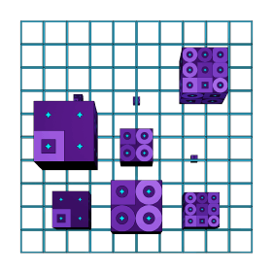

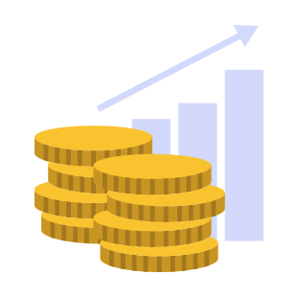
Different forms of “Shared Security” today:
Native
Rollups
Re-Staking
Native shared security is implemented at the protocol level, and is represented as a Layer 0 blockchain, working underneath Layer 1 chains.
Optimistic and zero knowledge rollups use a settlement layer to provide security and finality to their transactions.
Some protocols allow the use of already staked tokens to secure another network, usually through the creation of a derivative token.
but these different forms are not equal…

Slide 16

Deep Dive into Polkadot

Slide 17
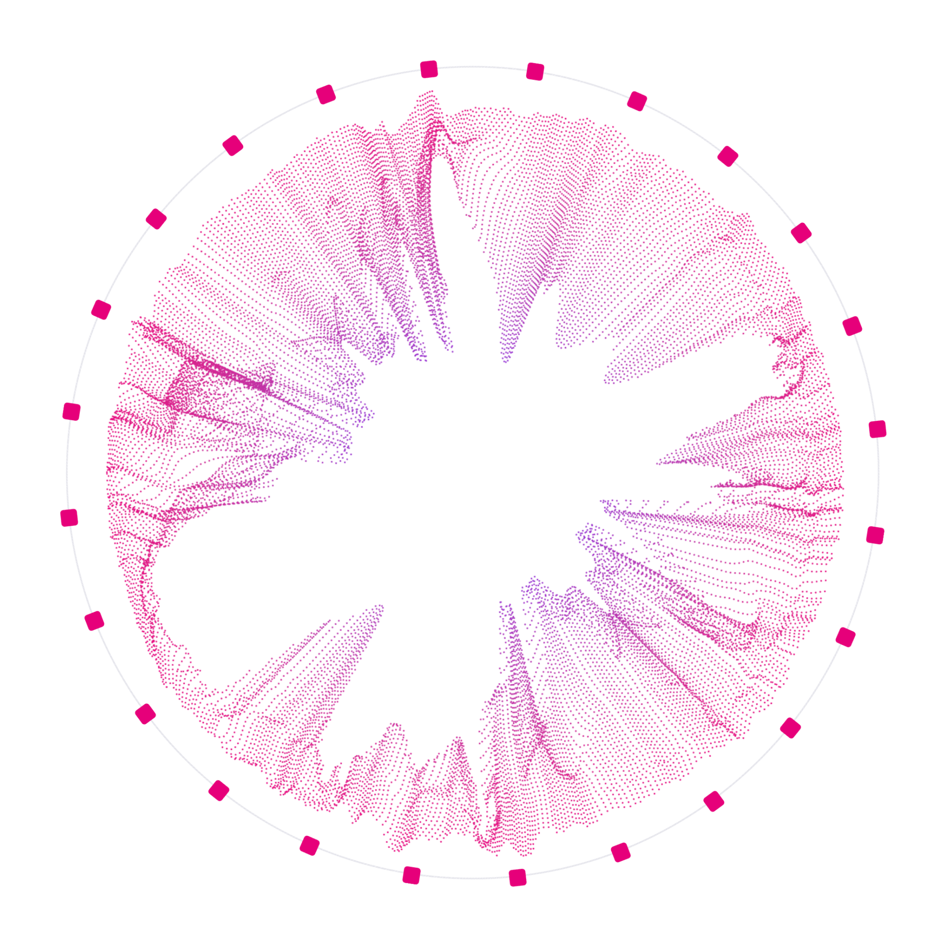
What is Polkadot?
Polkadot is a network that connects blockchains, which we call “Parachains”.
A vision toward a multi-chain future.

Slide 18
Polkadot’s Shared Security
Polkadot is unique in that it provides all connected parachains with the same security guarantees as the Relay Chain itself.
This is native to the protocol, and one of its core functionalities.
Notes:
Security in proof-of-stake networks depends on economics, so there can only exist a limited amount of security in the world because economic value is, by definition, limited. As the number of blockchains increases due to scaling issues on single chains, their economic value — and therefore their security — gets spread out over multiple chains, leaving each one weaker than before.
Polkadot introduces a shared security model so that chains can interact with others while knowing full well that their interlocutors have the same security guarantees as their own chain. Bridge-based solutions — where each chain handles its own security — force the receiver to trust the sender. Polkadot’s security model provides the necessary guarantees to make cross-chain messages meaningful without trusting the security of the sender.

Slide 19


The Building Blocks
Wasm
Parachains Protocol
Relay Chain
WebAssembly is a key part of enabling trust-free shared security and interoperability. It allows the Relay Chain to trustlessly validate the blocks of connected parachains.
The Parachains Protocol is comprised of many subsystems like Collation, Backing, Availability, Approval Checking, and Disputes. It is the most advanced multi-chain coordination software that exists today.
A coordination chain that manages its own block producers, parachain validators, consensus and finality across all parachains, and more. It is what many people think of when we say “Polkadot”, but is really just one small part of the overall ecosystem.

Slide 20
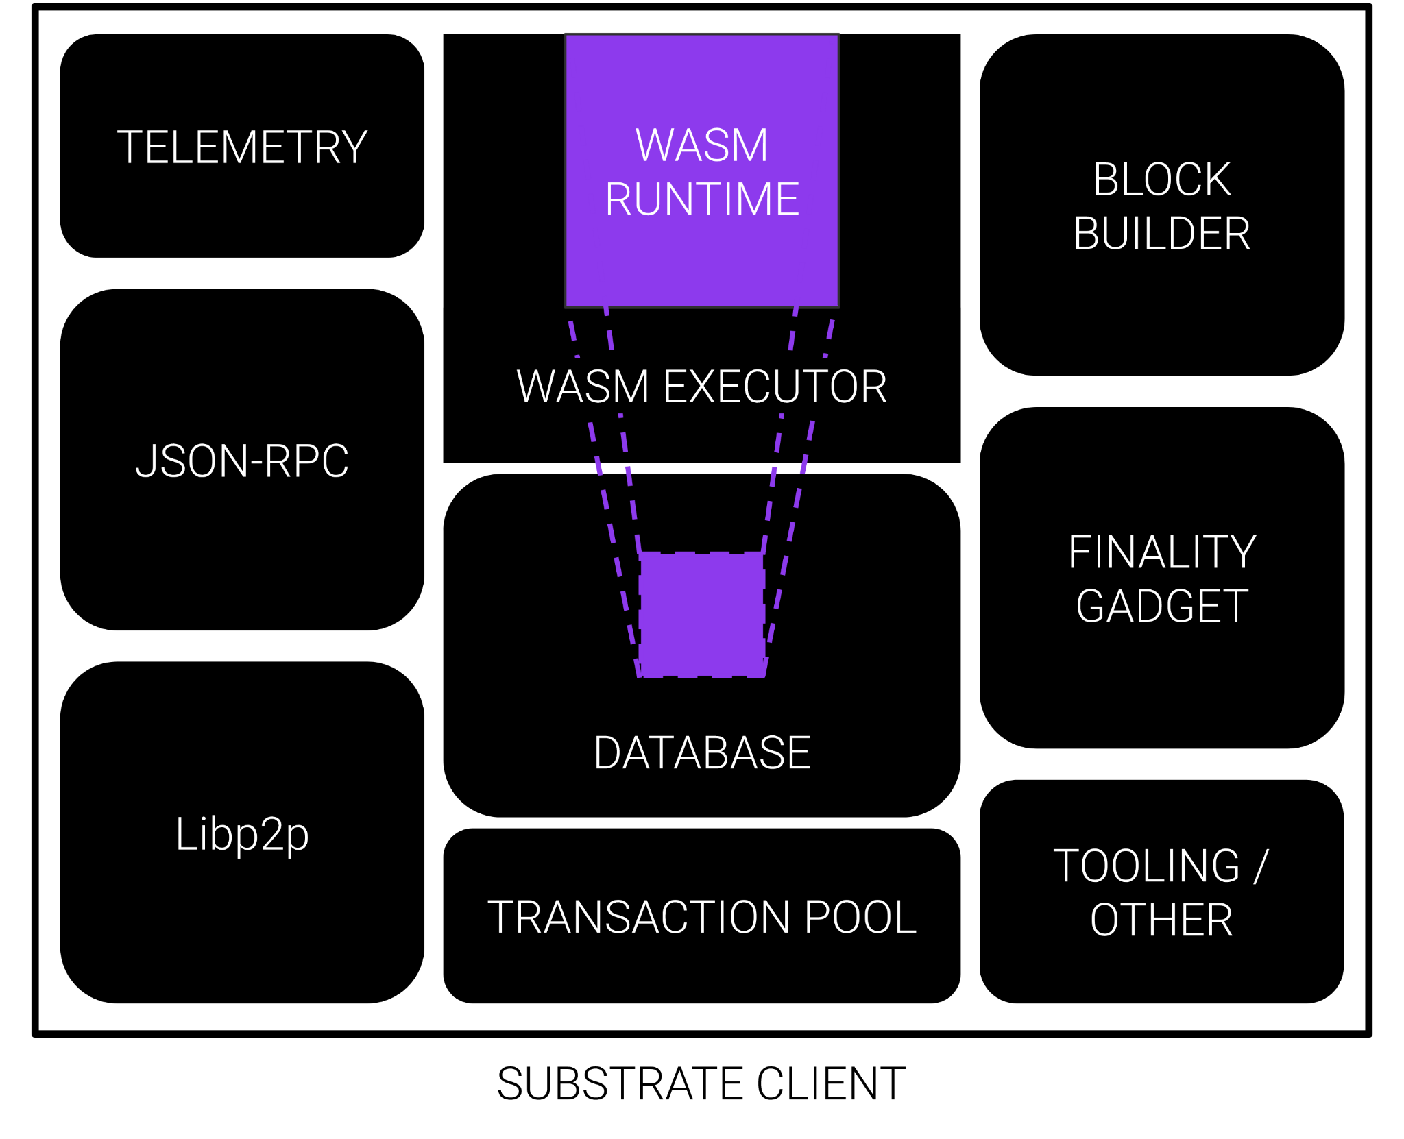
In the Polkadot ecosystem, each chain has their state transition function represented by a Wasm blob which is stored on the blockchain itself.
This has many implications, but the key point here is that it is very easy to share and safe to execute.

Slide 21
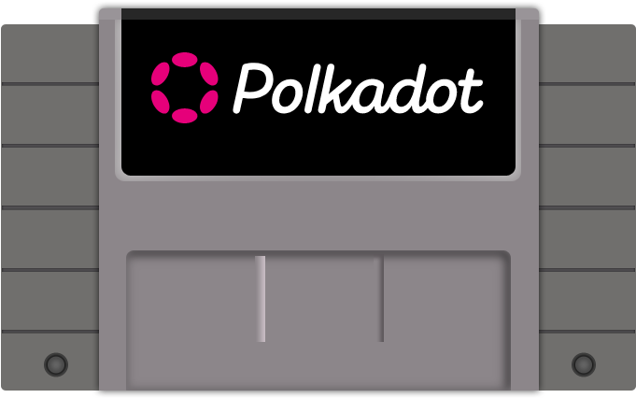
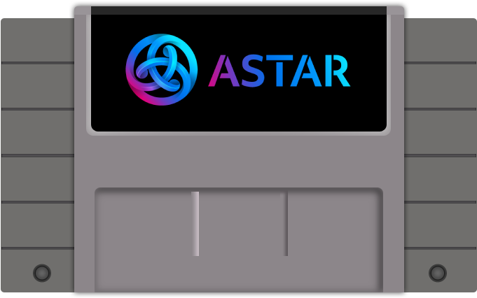
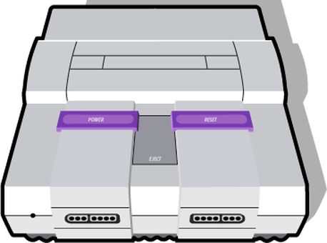
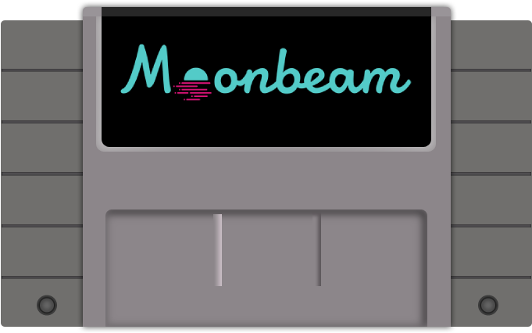
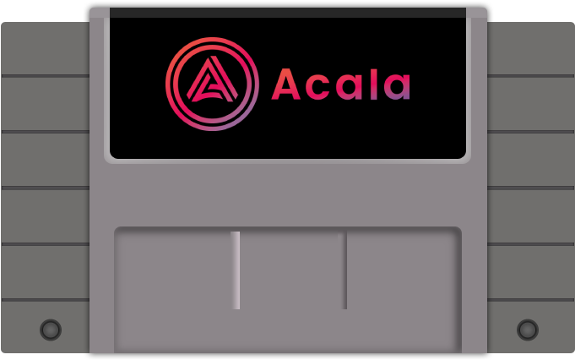
Basic Polkadot Client
Wasm Runtimes
Game Console Analogy

Slide 22
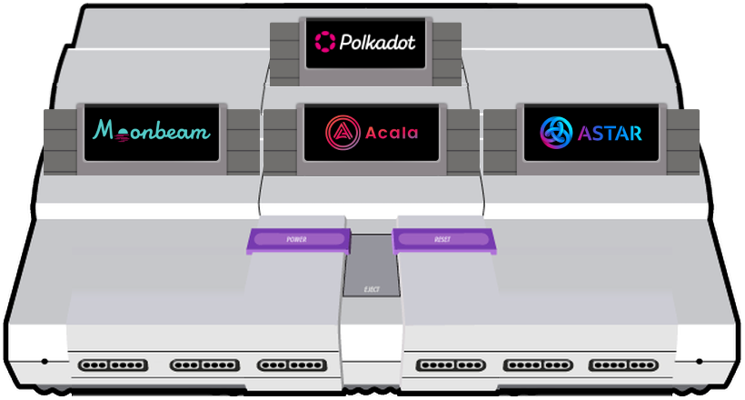
A Polkadot Validator Node

Slide 23

Polkadot Presentation
2023
Parachain Validation

Slide 24
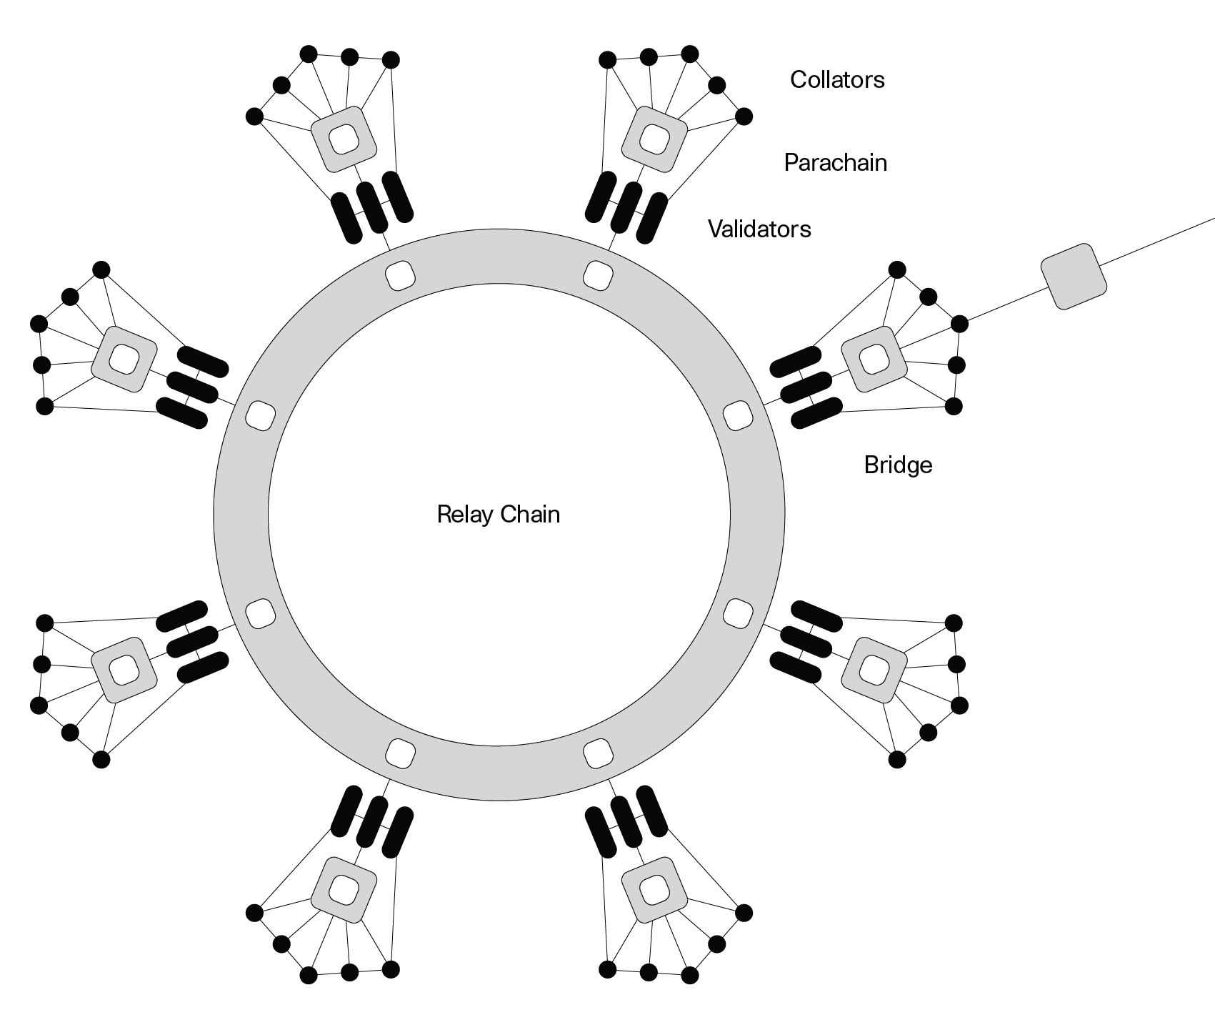
Execution Sharding
Execution Sharding is the process of distributing blockchain execution responsibilities across a validator set.
In Polkadot, all validators execute every relay chain block, but only a subset execute each parachain block.
This enables Polkadot to scale.
Notes:
Security in proof-of-stake networks depends on economics, so there can only exist a limited amount of security in the world because economic value is, by definition, limited. As the number of blockchains increases due to scaling issues on single chains, their economic value — and therefore their security — gets spread out over multiple chains, leaving each one weaker than before.
Polkadot introduces a shared security model so that chains can interact with others while knowing full well that their interlocutors have the same security guarantees as their own chain. Bridge-based solutions — where each chain handles its own security — force the receiver to trust the sender. Polkadot’s security model provides the necessary guarantees to make cross-chain messages meaningful without trusting the security of the sender.

Slide 25
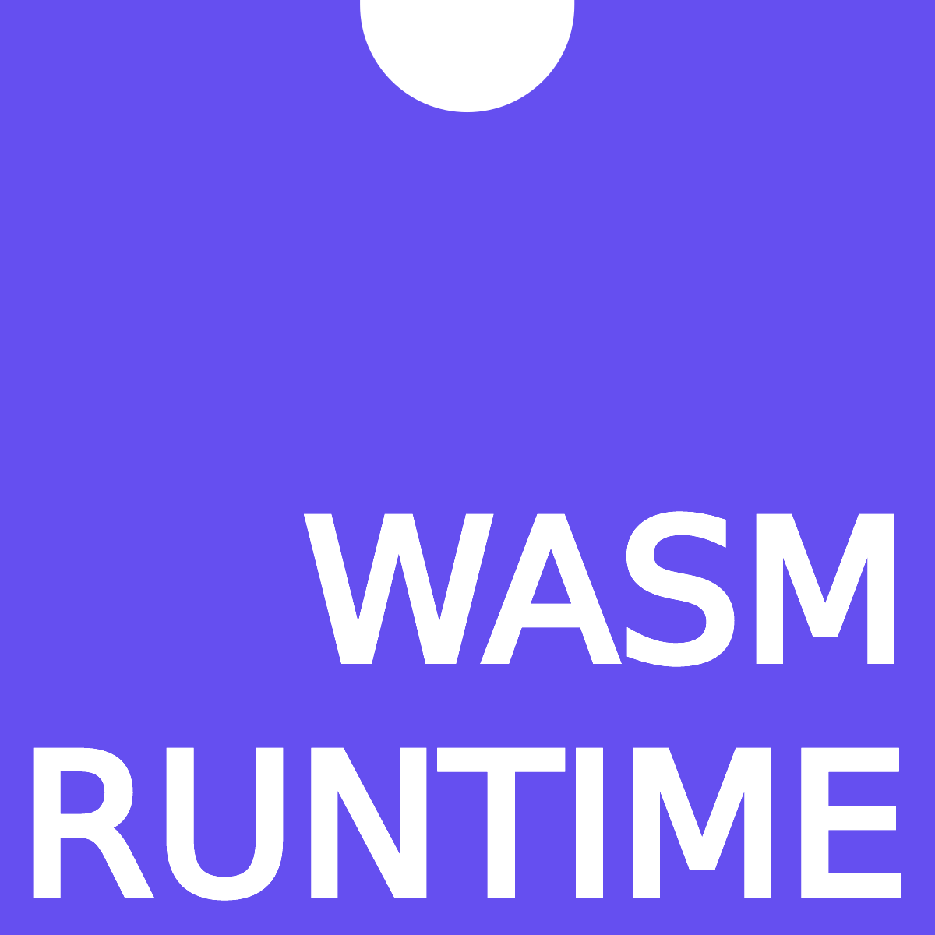
How to validate a block?
State Transition Function
Validates the Block
PoV
Block of Transactions
A
B
C
D
E
A’
B’
C’
D’
E’
Partial merkle trie with relevant data needed for transactions. (Proof of Validity)
New State Root
Generated

Slide 26
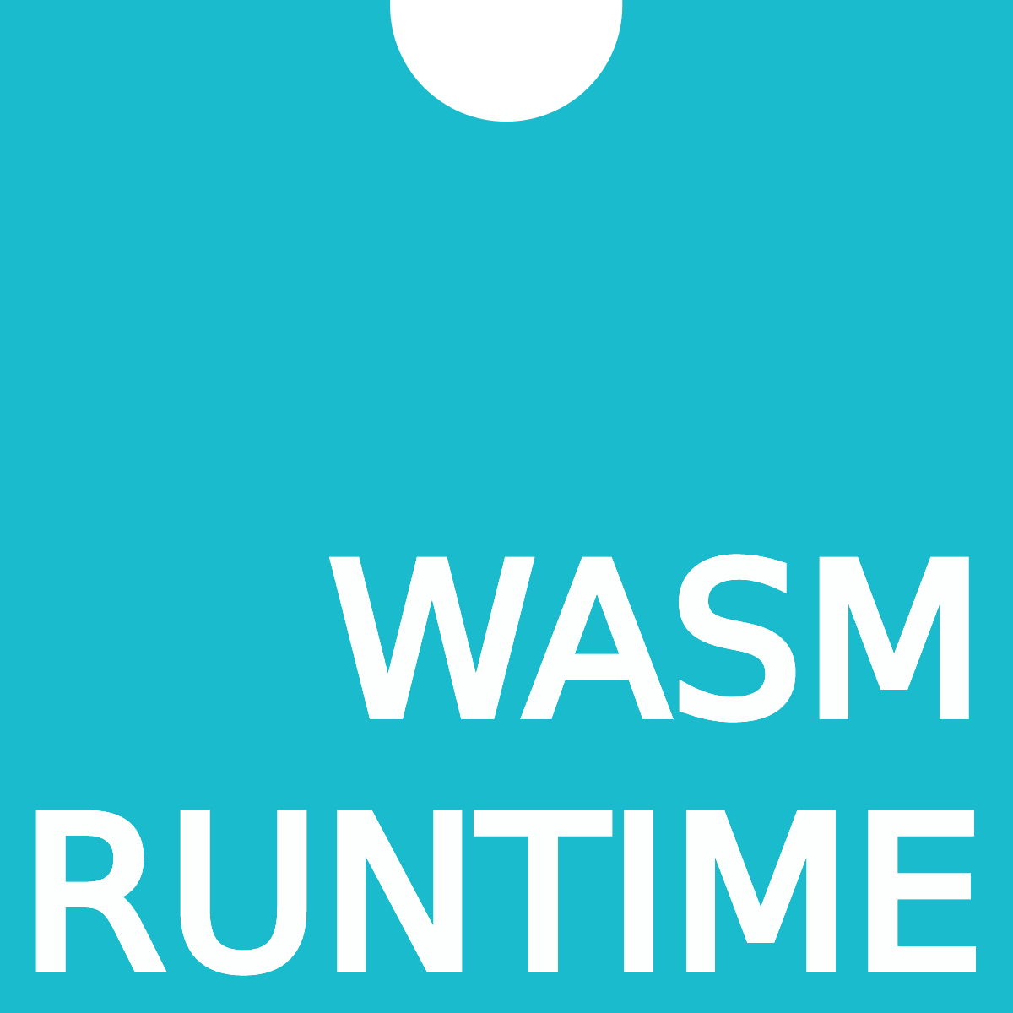
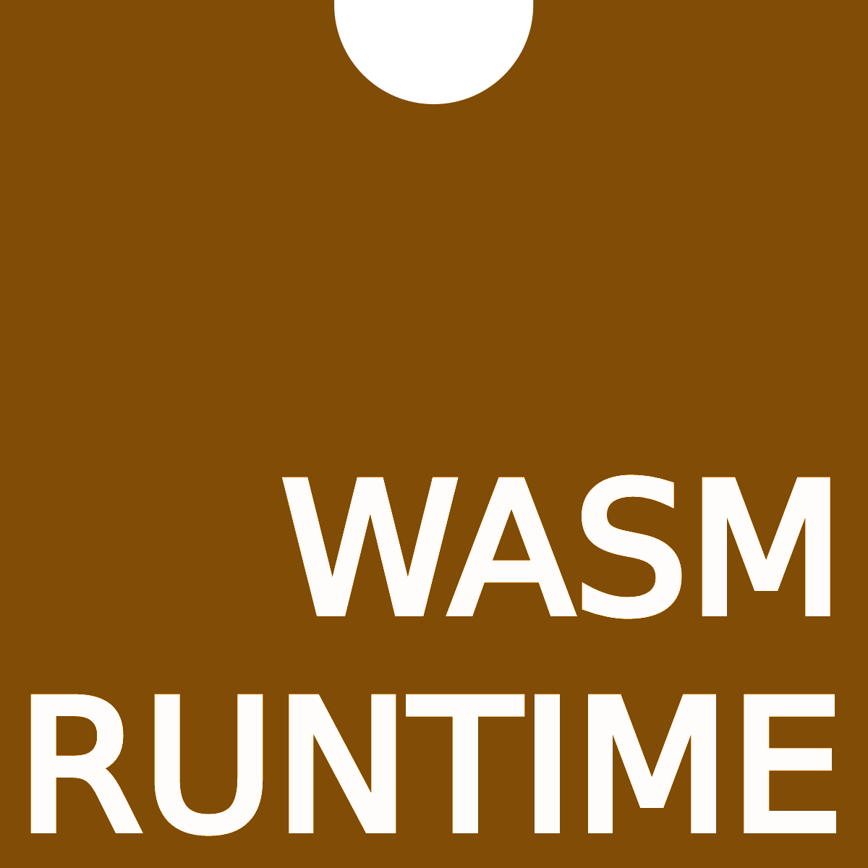
Parachains submit new blocks with a proof-of-validity to the network.
PoV
Block of Txs
A
C
E
Block of Txs
Block of Txs
PoV
PoV
A
C
E
A
C
E
ROOT
ROOT
ROOT
Wasm Runtime and latest state root for Parachains already stored on the relay chain.

Slide 27
Block of Txs
Block of Txs
Block of Txs
PoV
PoV
PoV
Parachains Protocol has new blocks that it needs to validate and include.
A
C
E
A
C
E
A
C
E
Polkadot Validators

Slide 28
Block of Txs
Block of Txs
Block of Txs
PoV
PoV
PoV
A random subset of validators are assigned to execute the parachain blocks.
A
C
E
A
C
E
A
C
E
The new state root is then committed to the relay chain so the process can repeat.

Slide 29
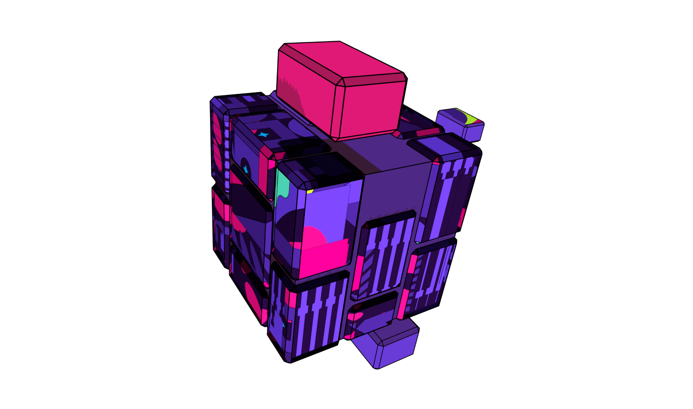
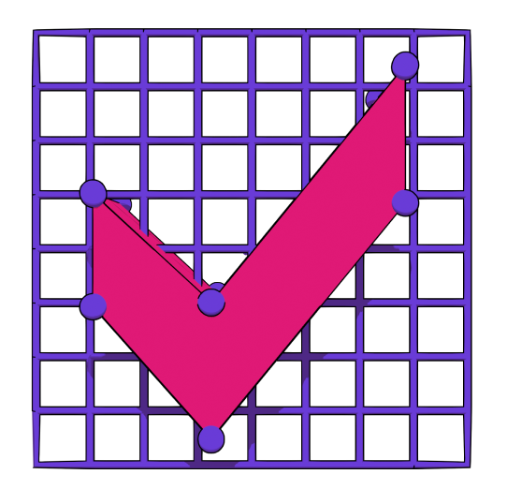
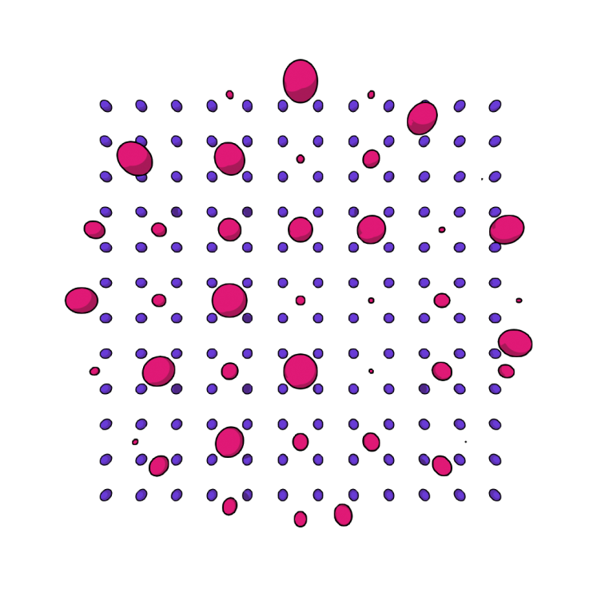
Polkadot Presentation
2023
How do we stop things from going wrong?
Data Availability
Approval Checking
Disputes Handling
Polkadot uses erasure encoding across the validators assigned to a parachain to make sure the data needed to validate a block stays available.
Every validator node is running an approval checking process for every parachain block in every relay chain block.
When someone disputes the validity of a parablock, all validators must then check the block and cast a vote. The validators on the losing side of the dispute are slashed.

Slide 30
Parachain Blocks Get Finalized
n+1
Relay chain block producers commit the new state root to the relay chain once the Parachains Protocol has been completed.
Thus, when a relay chain block is finalized all included parachain blocks will also be finalized!
The Parachain state committed on Polkadot is the canonical chain.
n
Parachain Blocks Finalizing with the Relay Chain
n-1
n-2
n-3

Slide 31
Trust-Free Interactions
n+1
This also means that finalization on Polkadot implies finalization of all interactions between all parachains at the same height.
So, shared security not only secures the individual chains, but the interactions between chains too.
n
Parachain Blocks and Interactions Finalizing with the Relay Chain
n-1
n-2
n-3

Slide 32
Wasm
Parachains Protocol
Relay Chain

Slide 33
Comparing Options

Slide 34
Seems to be protocol agnostic, and can be “backported” to new and existing chains.
Smaller / newer chains can rely on more valuable and stable economies.
As tokens are continually re-staked, the economic “costs” needed to attack secured chains decreases.
No real computational verification or protection provided by these systems.
Seems to ultimately fall back on centralized sources of trust.
Re-Staking Solutions

Slide 35
Not limited by the complexity of the on-chain VM.
Can be parallelized.
They can stuff a lot of data in their STF.
They can use compiled code native to modern processors.
Concerns around centralization and censorship of sequencers.
Long time to finality due to challenge periods. (could be days)
Settlement layers could be attacked, interfering with the optimistic rollup protocols.
Suffers from the same problems allocating blockspace as on-chain transactions.
On-chain costs to perform the interactive protocol.
Congestion of the network.
Optimistic Rollups

Slide 36
Honestly, they are pretty great.
Proven trustlessly.
Minimal data availability requirements.
Instant Finality (at high costs).
Exciting future if recursive proofs work out.
Concerns around centralization of sequencers and provers.
Challenging to write ZK Circuits.
Turing complete, but usually computationally complex.
Hard to bound complexity of circuits when building apps.
Suffers from the same problems allocating blockspace as on-chain transactions.
On-chain costs to submit and execute proofs on settlement layer.
Congestion of the network.
Zero Knowledge Rollups

Slide 37
Protocol level handling of sharding, shared security, and interoperability.
Easy to develop STF.
Anything that compiles to Wasm.
Probably the best time to finality, usually under a minute.
Data availability provided by the existing validators.
Much less concern of centralization from collators vs sequencers and provers.
Wasm is unfortunately still 2x slower than native compilation.
Requires lot of data being provided and available in PoV.
Certain limitations enforced to keep parachains compatible with the parachains procol.
Polkadot Native Shared Security

Slide 38
Converging ideas.
Exploring solutions.
Thank you
Follow me @shawntabrizi anywhere there is social media.

